Slide 1
Elementary Science Professional Development: Lessons Learned
MSELA 10.20.16
Jeff Winokur – Karen Worth
kworth@wheelock.edu
jwinokur@wheelock.edu
Wheelock College

Slide 2
Guiding Question
What knowledge and skills provide a foundation for developing teacher skills in creating questions that engage and challenge elementary students and lead to the construction of explanations?

Slide 3
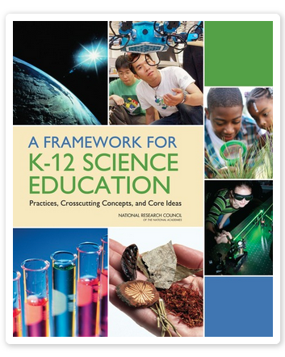
The Framework

Slide 4
The Practices
Ask questions (science) and solve problems (engineering)
Plan and carry out investigations
Make meaning from experience and data
Use mathematics and computational thinking
Construct explanations (science) and designing solutions (engineering)
Develop and use models
Engage in discussion/argue from evidence
Obtain, evaluate, and communicate info

Slide 5
Asking Questions and Defining Problems
Science begins with a question about a phenomenon,…and seeks to develop theories that can provide explanatory answers to such questions. A basic practice of the scientist is formulating empirically answerable questions about phenomena, establishing what is already known, and determining what questions have yet to be satisfactorily answered.
From: A Framework for K-12 Science Education: Practices, Crosscutting Concepts, and Core Ideas (2012) NAP P.50

Slide 6
Science asks…
What exists and what happens?
Why does it happen?
How does one know?
How does one communicate about phenomena, evidence, and explanations?
From: A Framework for K-12 Science Education: Practices, Crosscutting Concepts, and Core Ideas (2012) NAP P.54

Slide 7
Asking Questions and Defining Problems
Engineering begins with a problem, need, or desire that suggests an engineering problem that needs to be solved. A societal problem ….may engender a variety of engineering problems….. Engineers ask questions to define the engineering problem, determine criteria for a successful solution, and identify constraints.
From: A Framework for K-12 Science Education: Practices, Crosscutting Concepts, and Core Ideas (2012) NAP P.50

Slide 8
Engineering asks….
What can be done to address a particular human need or want?
How can the need be better specified?
What tools and technologies are available, or could be developed, for addressing this need?
How does one communicate about design solutions?
From: A Framework for K-12 Science Education: Practices, Crosscutting Concepts, and Core Ideas (2012) NAP P.54

Slide 9
Drops of water on surfaces
explore briefly
think about a concept related to this phenomenon
make a list of questions for a particular grade level – keep track of these on chart paper at each table

Slide 10
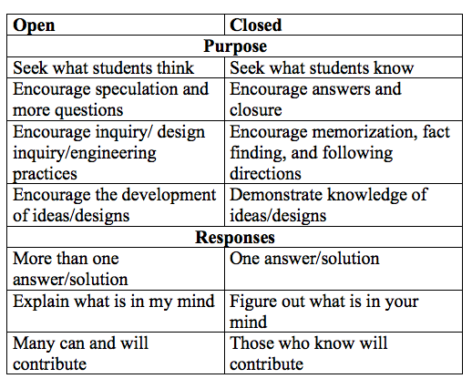
Open and Closed Questions

Slide 11
Productive Questions
“A good question is the first step toward an answer; it is a problem to which there is a solution. A good question is a stimulating question, which is an invitation to a closer look, a new experiment or a fresh exercise. …. I would like to call such questions “productive” questions because they stimulate productive activity. “
Elstgeest, J (2001) The right question at the right time, in Harlen (ed) Primary Science: Taking the Plunge, 2nd ed, Heinemann.

Slide 12
Characteristics of Productive Questions
Support the purpose of a particular stage of inquiry or engineering design
Relate to the content
Motivate students to take next steps in their learning
Promote activity, thinking, and reasoning

Slide 13
Characteristics of Productive Questions
Are equitable—refer to common experiences so all students can participate
Are open—are neither too broad or unfocused nor narrow and specific and invite multiple perspectives
Are person-centered—encourage the ideas of all students

Slide 14
An Arc of Questions
But simply posing a variety of questions hardly creates a climate for inquiry. At least as important is the way in which teachers respond to the answers their questions provoke. Thus, recent research (Sadker and Sadker 1985) suggests that too often students' replies meet with little more than a passing "uh-huh" Such responses can stop inquiry dead in its tracks. In place of such dead-end situations, skilled teachers give an exchange of questions a life-course.
Wolf, Dennis Palmer. "The Art of Questioning.” Academic Connections; p1-7, Winter 1987. p.5

Slide 16
Not So Elementary: Content Knowledge
Evidence suggests that the most critical content knowledge for elementary school teachers is a “profound understanding” of the concepts taught in elementary school. A profound understanding means that teachers understand the content they are teaching in-depth, accurately, and without confusion. (p.18)

Slide 17
Not So Elementary: Student Thinking
Exposure to student thinking is considered to be an important part of developing pedagogical content knowledge, and arguably to content knowledge, most relevant to student learning. (p. 20)

Slide 18
Not so Elementary: Pedagogical Content Knowledge
Teachers with weak science pedagogical content knowledge often prioritize students enjoying science and conducting activities, without a connection to scientific thinking that will truly deepen student understanding of science. This has a profound impact on student learning. (p. 24)

Slide 19
What do we think teachers need in order to be able to construct questions that push students to construct reasonable, evidence-based explanations?

Slide 20
A New Take
Ask a person a question and she inquires for a day; teach a person to question and she inquires for life.
Adapted from Wolf, Dennis Palmer. "The Art of Questioning.” Academic Connections; p1-7, Winter 1987. p.11
Notes:
Zach MIT exam

